Slide 1


AI VOICE ASSISTANT
Brainware Group Of Institutions - SDET
department of
Electronics & Communication Engineering
Prepared By :
Souvik Saha (BSSE/UT/EC/17/052) Rounak Chowdhury(BSSE/UT/EC/17/051) Indrani Majumder (BSSE/UT/EC/17/055) Sabyasachi Dhar (BSSE/UT/EC/17/056)

Slide 2
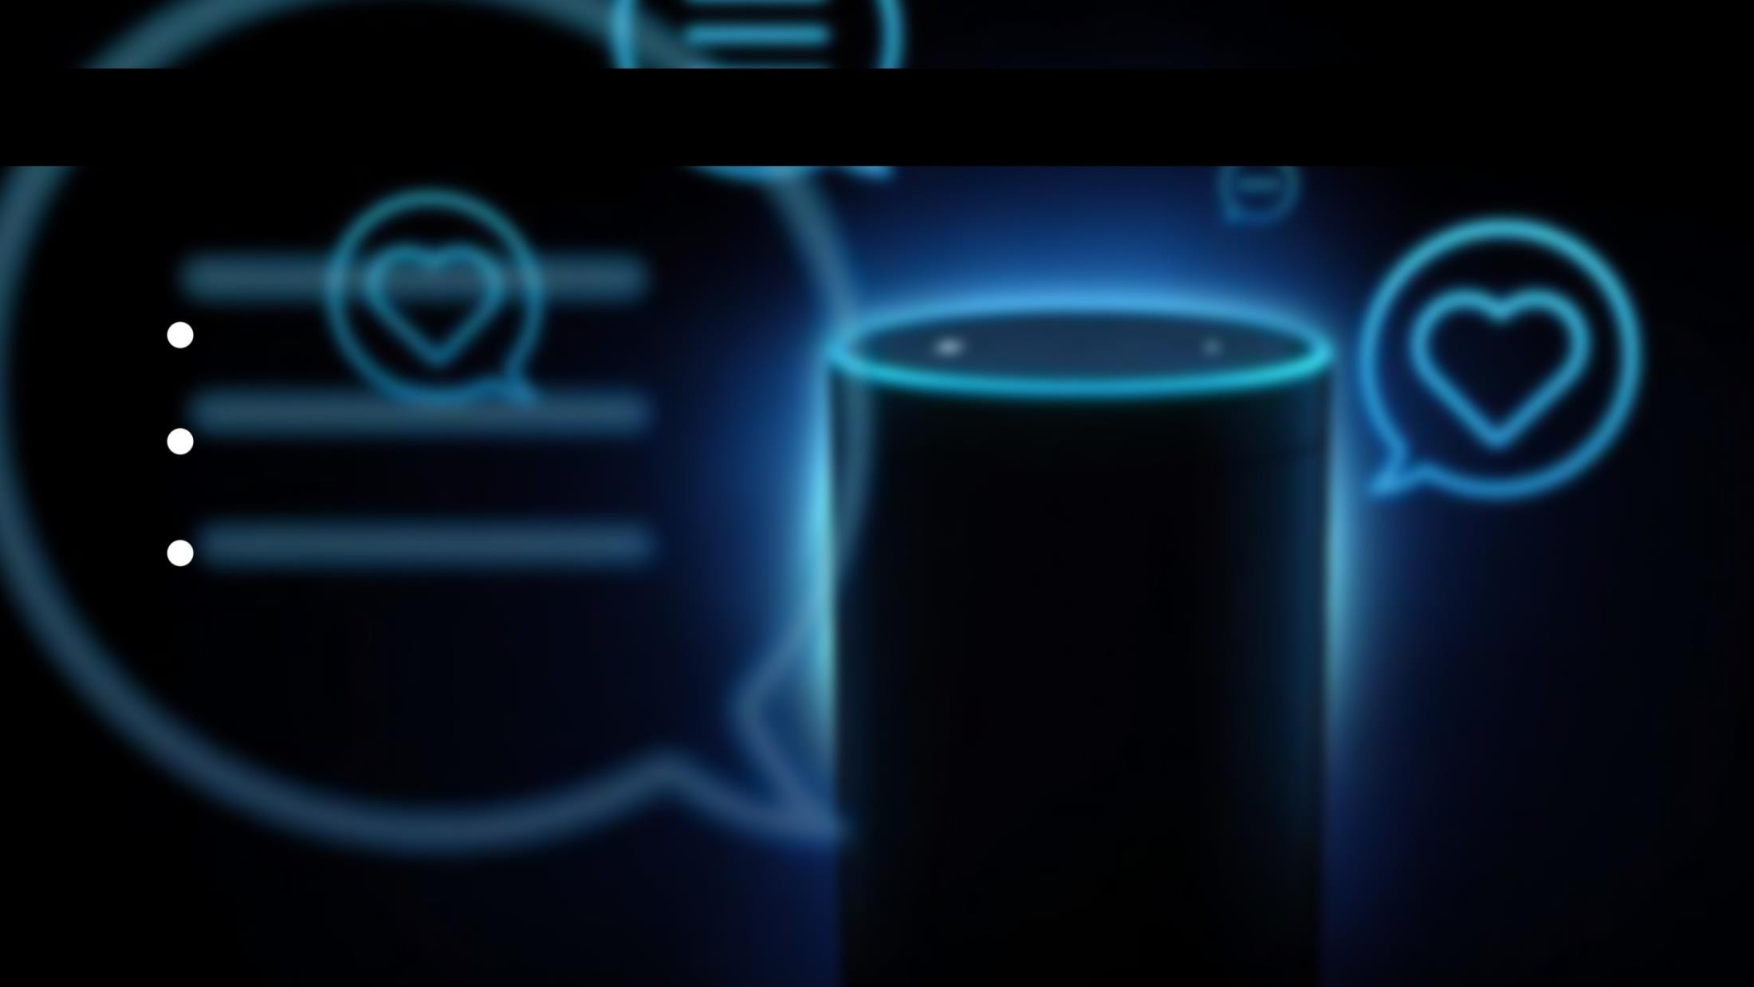


INTRODUCTION
What is AI personal assitant ?
Concept of an artification personal assistant. The combination of :
Automatic Speech Recognition Artificial Inteligence
Natural Language processing

Slide 3
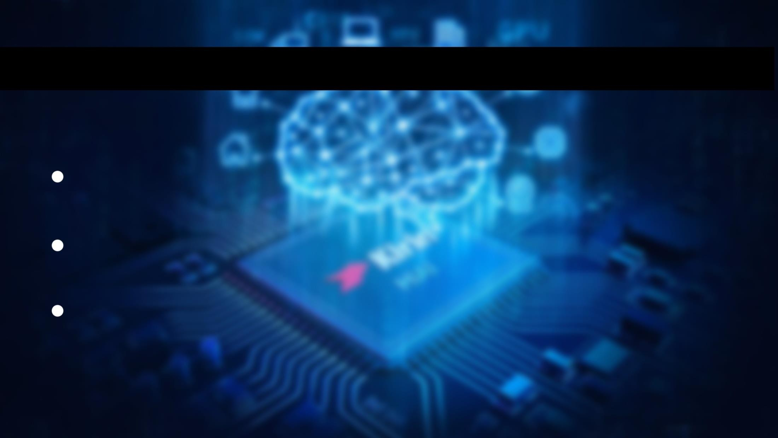



BASIC CONCEPT USED
The working of voice assistant uses following principle
Natural language processing :
To understand user’s speech input
Automatic speech recognition :
To understand command according to user’s input
Artificial Intelligence :
To learn things from users & patterns , store all the informations for better accuracy

Slide 4
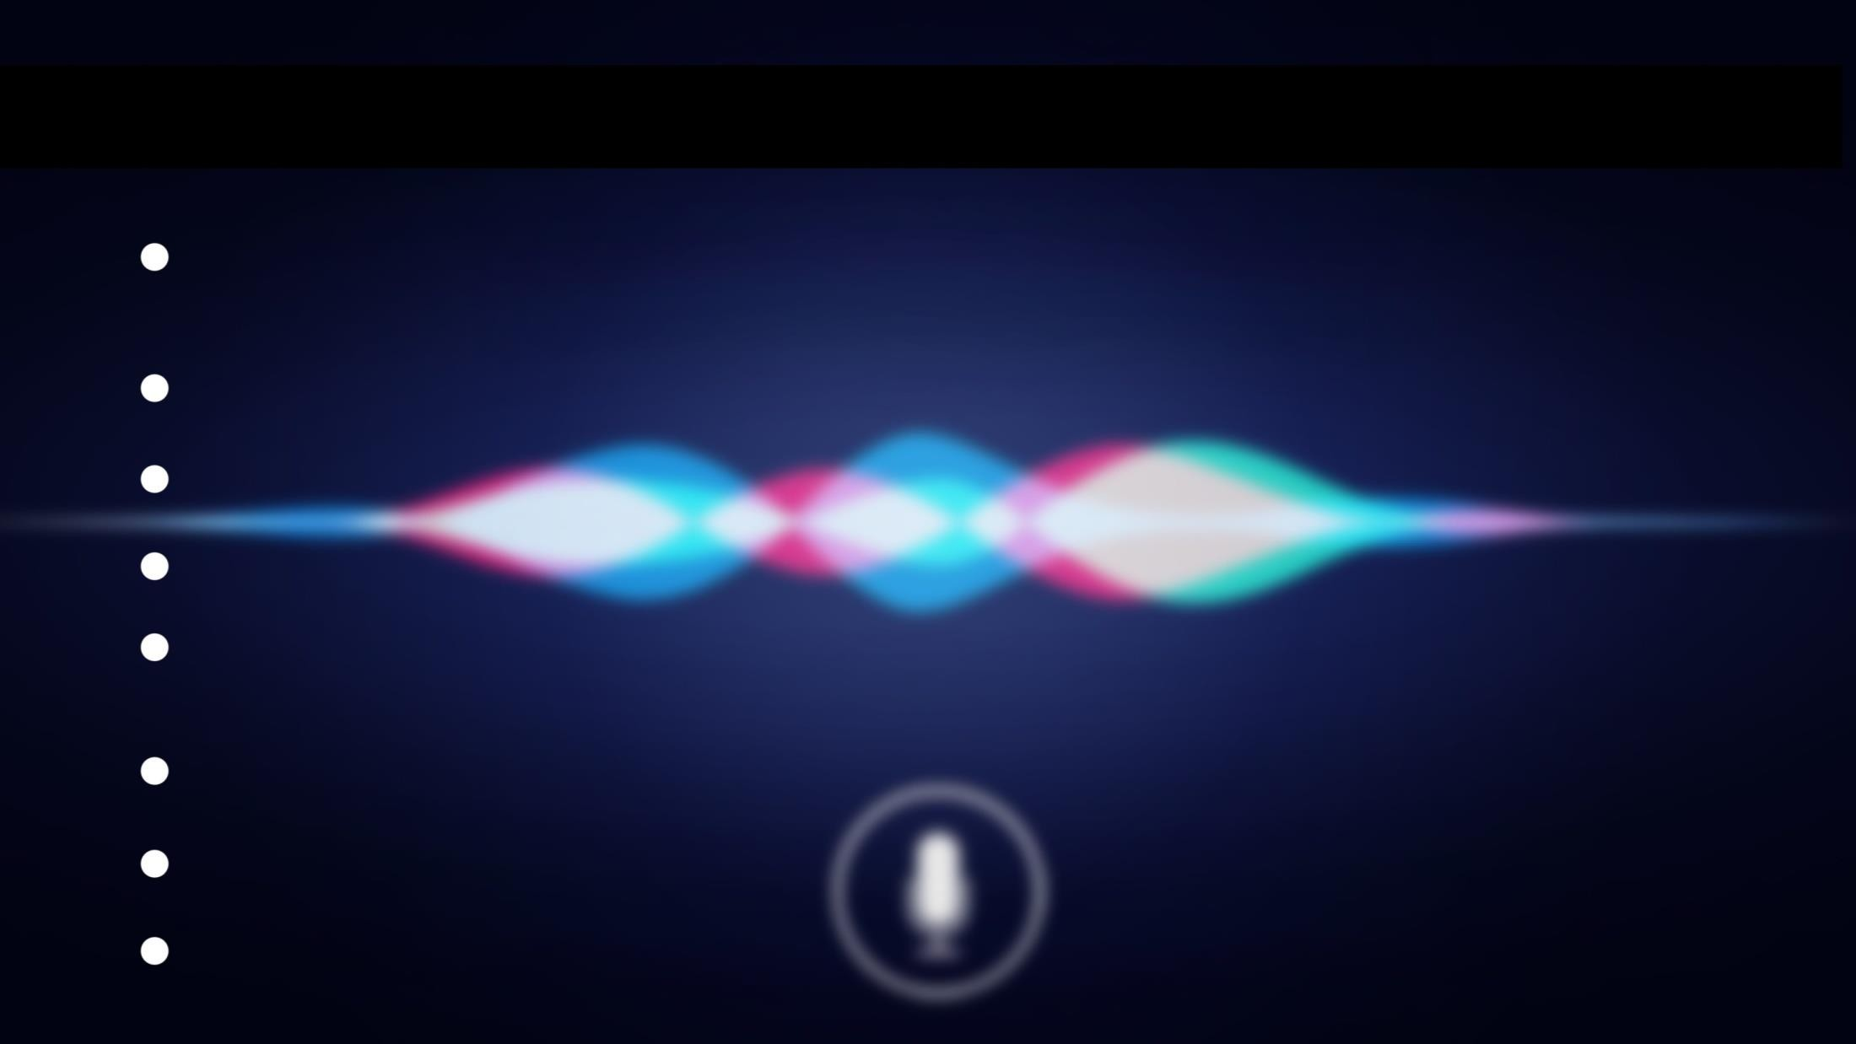
HISTORY
IBM introduce the IBM shoebox, the first digital speech recognition tool. It recognized 16 words and digit. in 1961
Dragon launches ‘Dragon dicate’ the first speech recognition product for consumers in 1990 Microsoft introduces speech recognition feature for office xp in 2001
Apple introduces ‘Siri’ in 2011 Gogle launches ‘google now’ in 2012
The first chatterbot was ‘ELIZA’
‘JULIA’ is the example of second generation chatterbot ‘ALICE’ is the example of third generation chatterbot

Slide 5
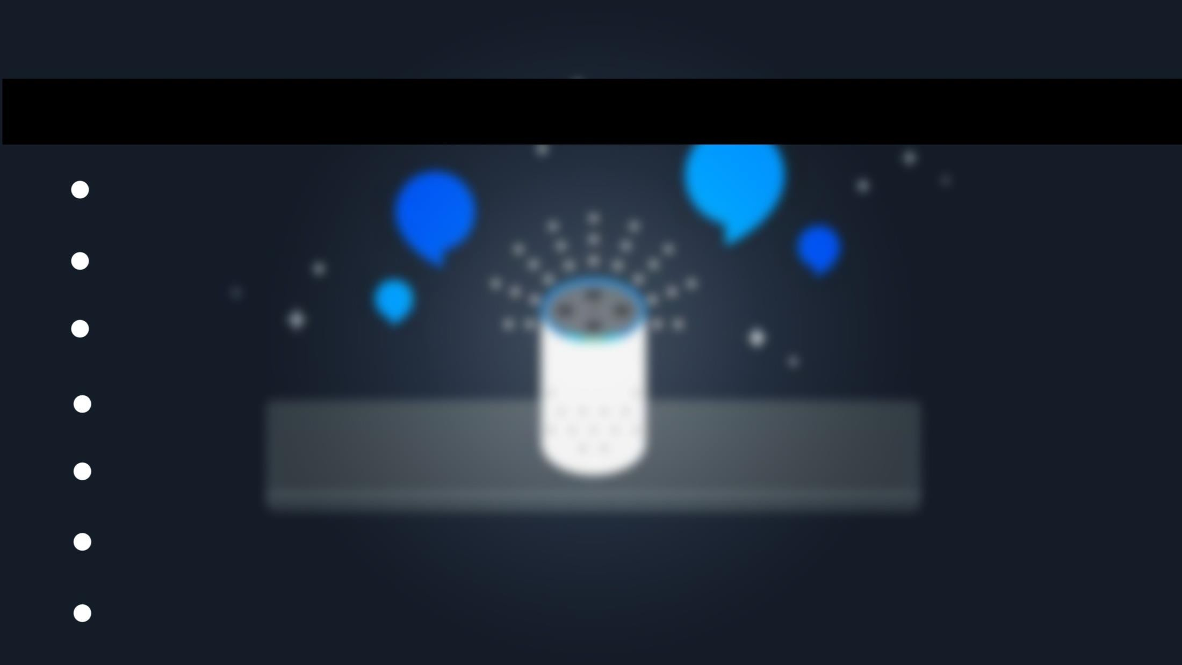
USES OF VOICE ASSISTANT
Play Music
Controll your devices & your smart home Make life easier with skills
Entertain the kids
Get news , weather and traffic Scheduling your day
Open apps on phone or PC

Slide 6
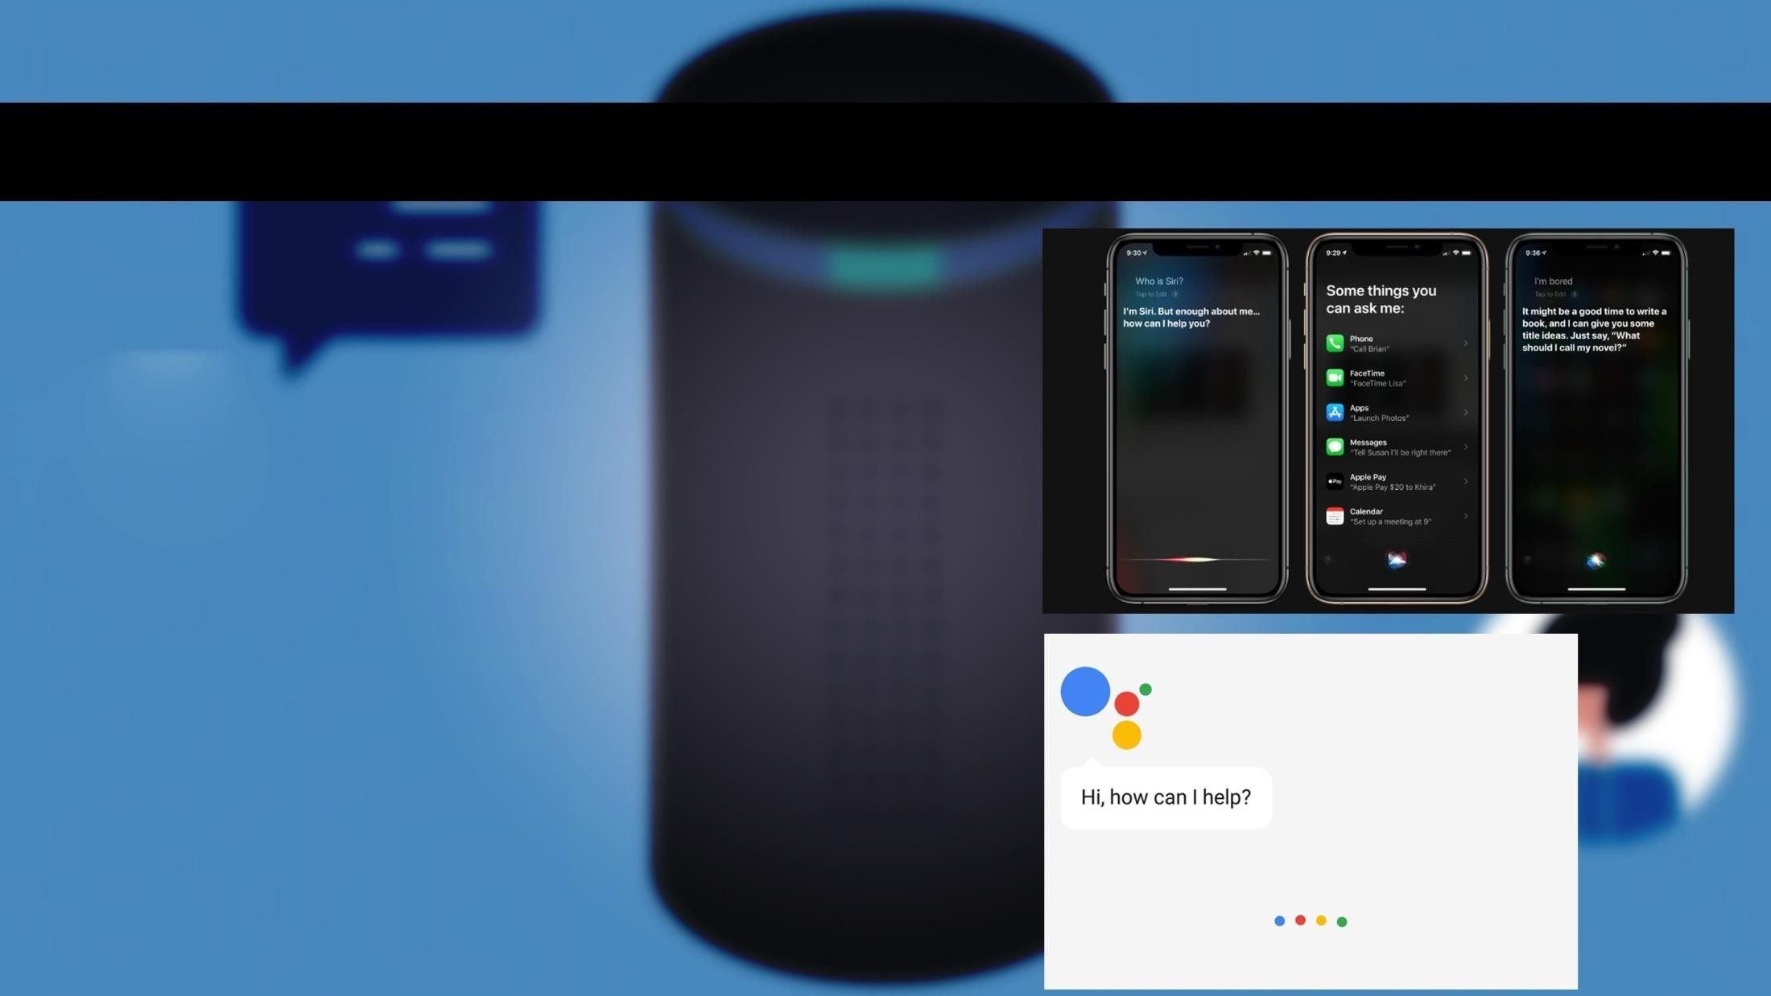
POPULAR VOICE ASSITANT
SIRI :
Siri by Apple became the first digital virtual assistant to be standard on a smartphone
when the iPhone 4s came out on October 4, 2011. Siri moved into the smart speaker world when the HomePod debuted in February 2018.
Google Now : Google Now (which became Google
Assistant) on the Android platform followed. It also works on Apple’s iOS, but has limited functionality.

Slide 7
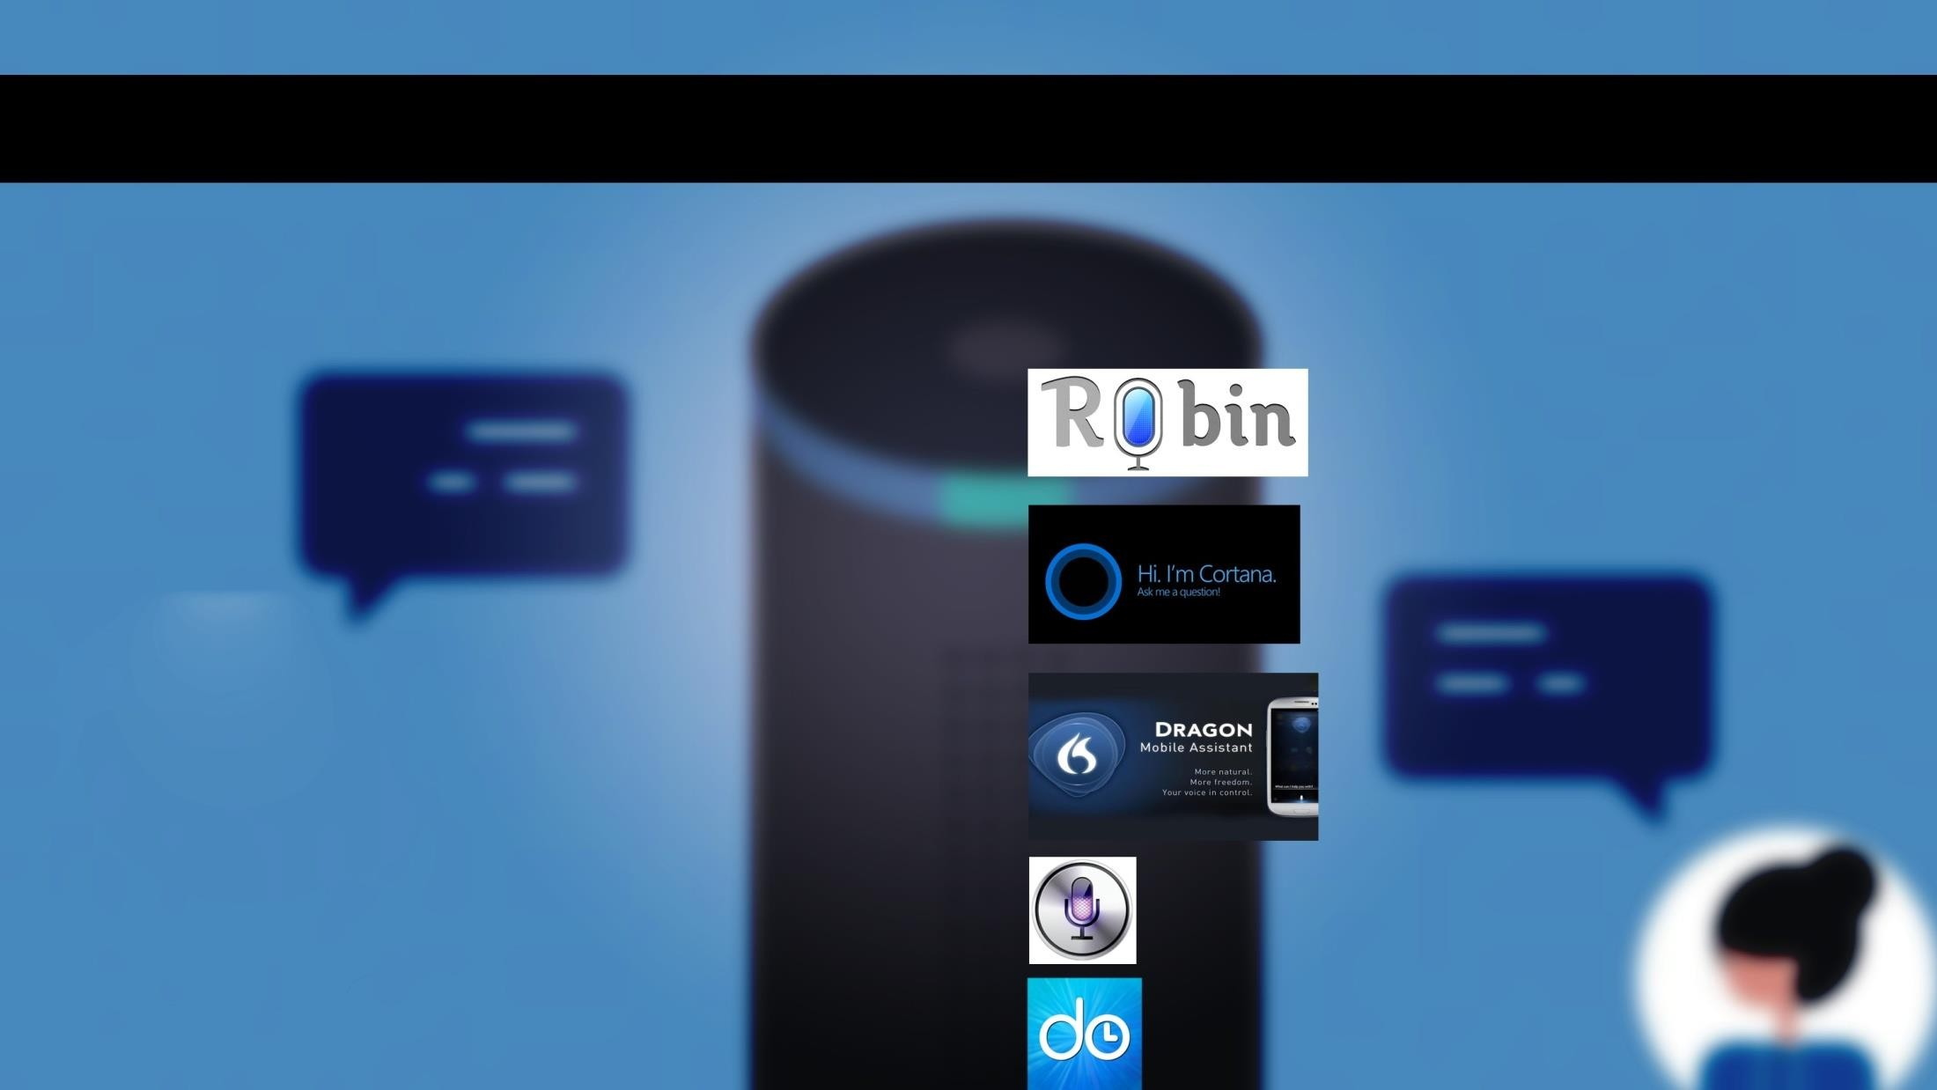
POPULAR VOICE ASSITANT
And here are some others voice assitants name :
Robin (Android)
Cortana
(Windows)
Dragon Go
(IOS)
Evi
(Android)
EasilyDo
(Android )

Slide 8
Some important python modules
Pyautogui : we use this module for automation purpose.
Selenium : It’s a high level Web – scrapping tool.
Open CV : With openCV we can detect faces and much more
Pyaudio : It’s a very important module for our voice assistant ,without it our voice assistant won’t work.
BeautifulSoup : we can scrap a particular data with beautifulSoup

Slide 9
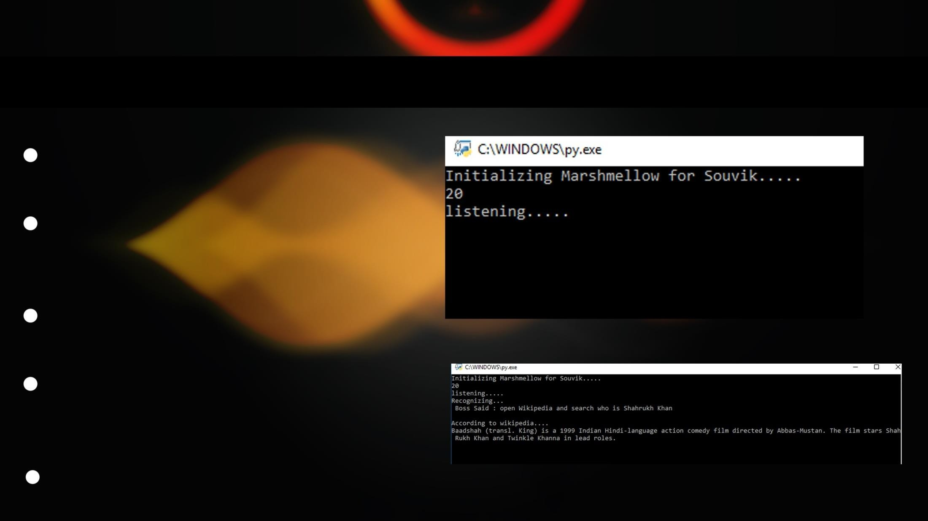
Making Our Own Personal Assistant
we can make our own personal assistant by using python programming language.
we need to import some modules name pyttsx3 , speech-recognition , pyaudio, sys, pywhatkit and some other modules.
We wil use ‘sapi5’ for voice recognition , which is provided by microsoft.
In this program we shall use ‘if - else’ condition. After few lines of coding we will able to make our own personal voice assistant.
Here are some pictures of our own personal assistant.

Slide 10

Advantages of Voice assistant
Store various information
Recognize voice commands
Control various applications of device & home
Reminds you important things on accurate situation or location
Helps you to plan your whole day
we can talk to the bot , if the bot is well trained.

Slide 11
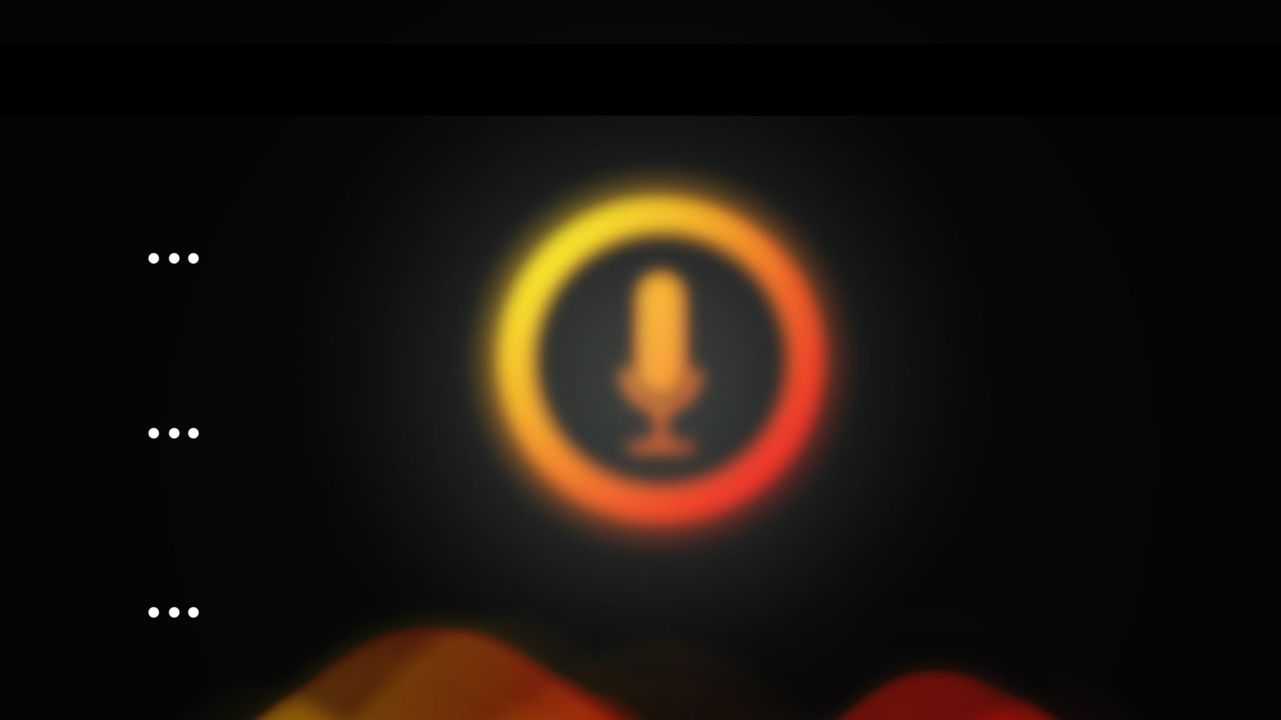
1. Internet access :
Disadvantages of Voice assistant
PVA(personal voice assistant) needs internet connection to give desired output.
Listening Problem :
PVA get problem to process wrong pronounced words and miscellaneous words.
Navigation Language :
Most of PVA’s can understand only english language

Slide 12
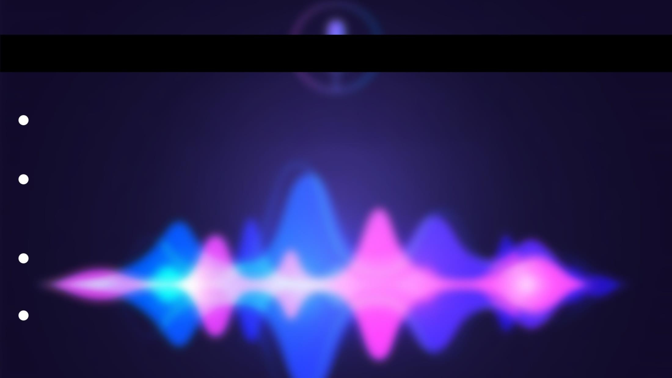
Future of voice assistant
Your voice assitant will be continually prompting you with suggestion and taking instructions and will know more about youthan perhaps you do yourself.
voice assistant is always improving and learning ,AI companies use data from existing systems to improve what assistants can do.the voice assistant might get so smart that it will automatically order a pizza if you say you’re hungry. It will use existing data from your previous purchases to come to the conclusion that saying you’re hungry equals ordering a pizza.
The Atlantic, “A subfield of AI called computational creativity forges algorithms that can write music, paint portraits, and tell jokes.” These capabilities will help smart speakers “show emotion” and “think” for themselves without being scripted.
We can expect this device to be implanted and permanent.

Slide 13
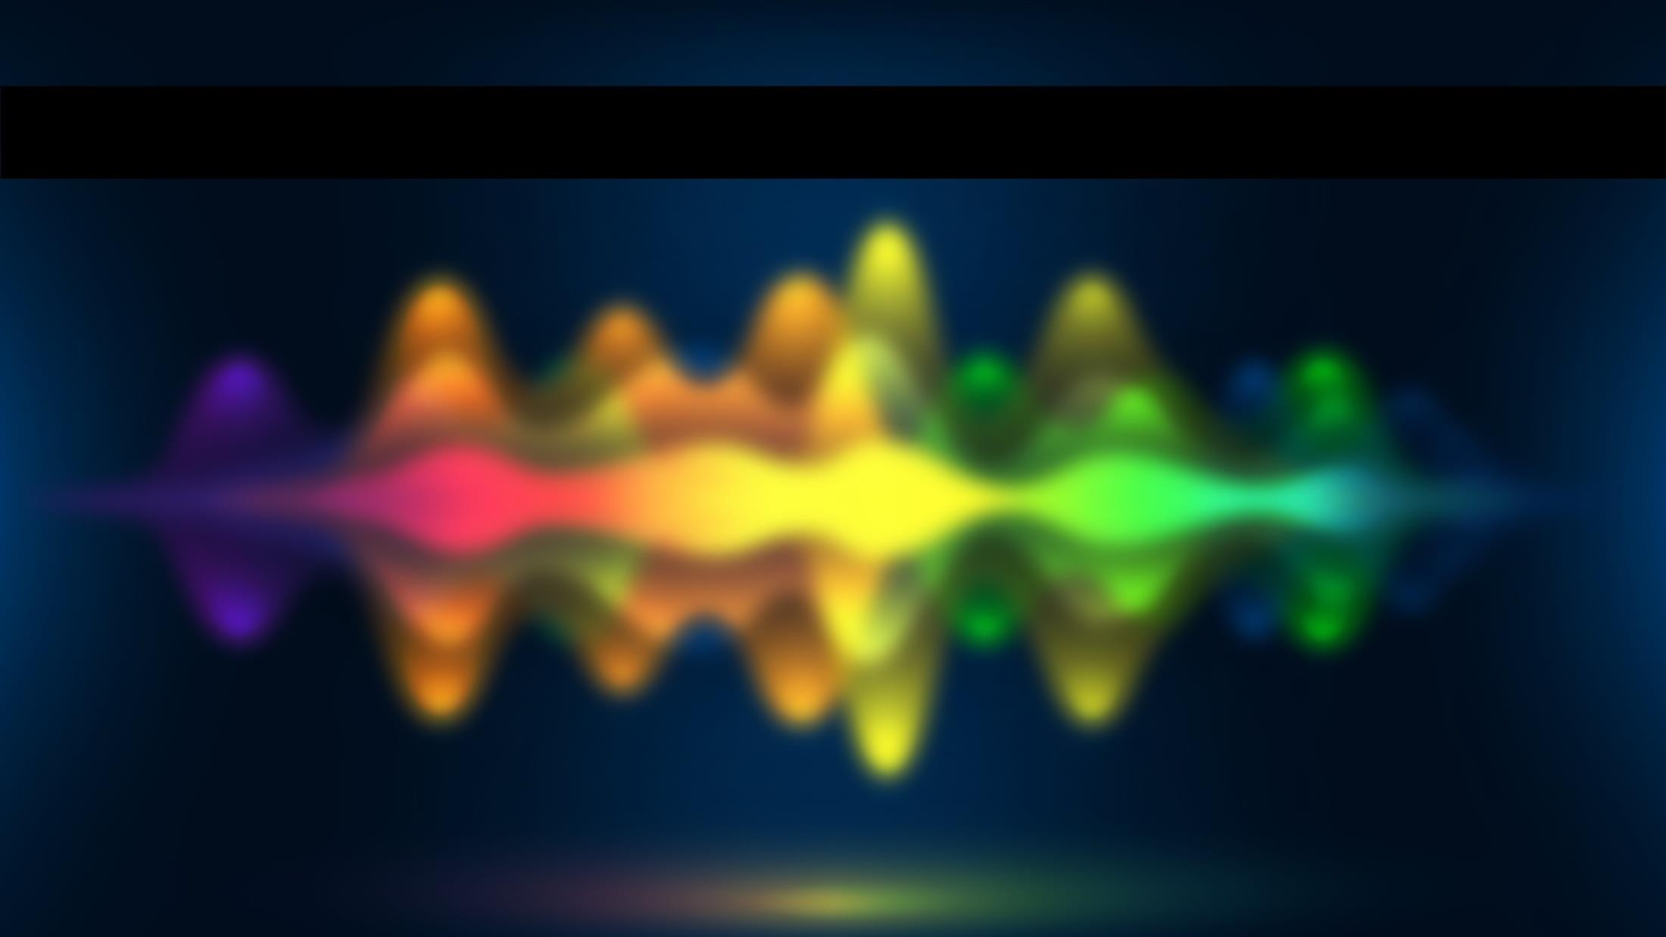
Future of voice assistant
Voice assitant are very effective way to organize your schedule. Now there are many personal digital assitant application available in market for various device platform.
Personal voice assitants are more portable and you can use them anytime. They also have lot of informations about youself. Having a personal assistant with access to the unlimited knowledge stored on the internet - isn’t this what mankind dreams about?

Slide 14
THANK
YOU :

